Slide 1
Power Puff Pets

Slide 2
WHO WE ARE
Power Puff Pets
We are a mobile pet store offering a wide range of products and services to pets and their owner.

Slide 3
Key Performance Indicators
01.
02.
Highest Quality
Rasing Awareness
03.
04.
Business Growth
Be Number 1 Choice

Slide 4
01
Raising Awareness
Proper care and diet of pets.

Slide 5
Business Objective
To build a loyal customer base by gaining their trust in providing the best information to care for their pets, therefore increasing sales and traffic.

Slide 6
Benchmark and Why?
Benchmark
Why?
The average years lived compared to the average lifespan of each species of animals.
Below
Because If we manage to increase the average years lived to be closest to the lifespan we have succeeded
But the goal isn’t to just increase the number of years but to also make sure those years are enriched and full of health love and care.

Slide 7
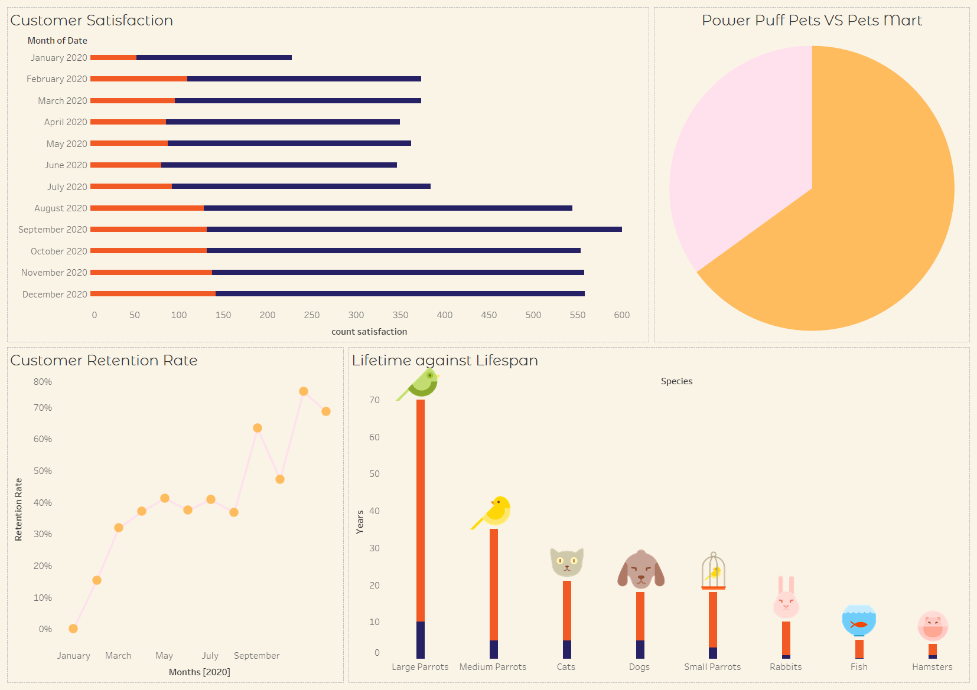
Dashboard

Slide 8
End Target
Enriched
Happy
Active
Healthy
Enhancing mental health
Increase ↑
Staying active
Improving overall health

Slide 9
Strategy to Meet Benchmark
Consulting Services
Check-ups
Feedback
Evaluation
Proper diet, behavioral issues, basic care
01
02
Annual wellness check-ups
On proper care to ensure optimum health
03
04
Comparing each annual check up

Slide 10
02.
Highest Quality
Provide the highest quality of services

Slide 11
Business Objective
Services:
Products
To provide the best services, care, and products.
Consulting
Grooming
Subscription
Food
Toys
Accessories
Supplies
Vitamins and Supplements
Grooming Products

Slide 12
Benchmark and Why?​
Benchmark:
Why
By taking customer feedback after giving the services
Meeting
When we receive a positive feedback from customers, that indicate their satisfaction with the quality service

Slide 13
Dashboard

Slide 14
End Target
Increase number of customers
Diversify the products and services provided
Provide a reliable constant supply of products for pet owner’s

Slide 15
Strategy to Meet Benchmark​​
Take consideration of customer's feedback
01
02
Keep improving our services and use the highest quality products
Keep looking for new trends
03
04
keep our business in tune with customers' needs

Slide 16
03.
BUSINESS GROWTH
ARE WE IN THE RIGHT DIRECTION?

Slide 17
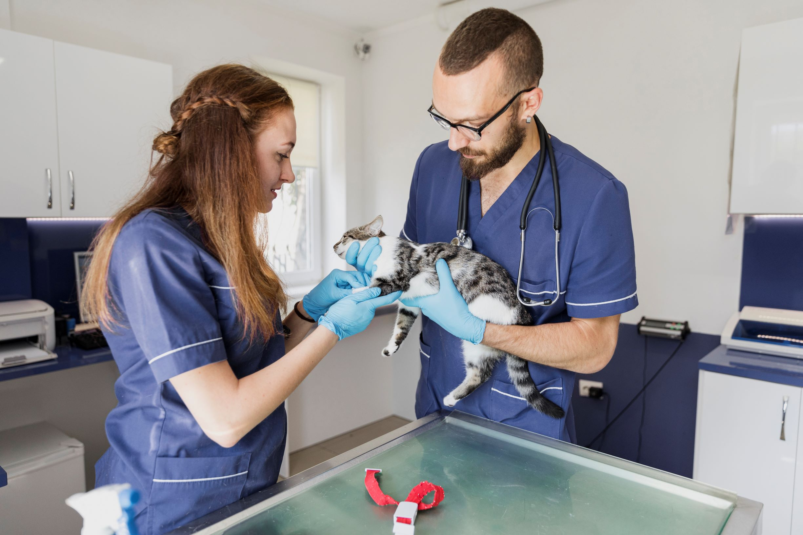

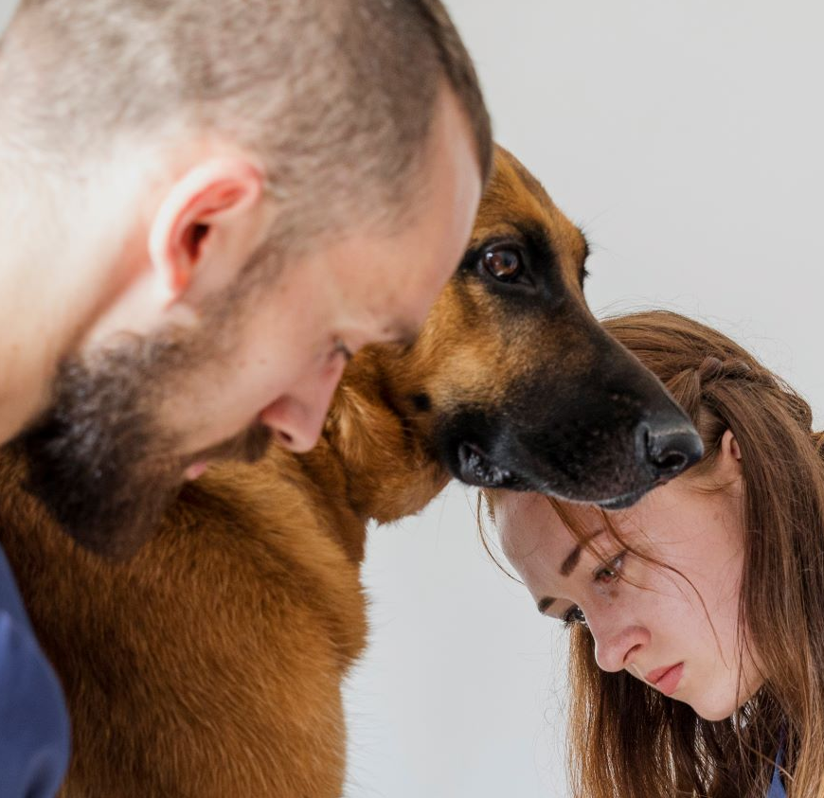
GOALS AND BUSINESS OBJECTIVES
GOAL
OBJECTIVE
To grow and expand our business
To provide a larger variety of services and products will help bring in more customers and increase overall sales and success of the business.

Slide 18
BENCHMARK AND WHY
BENCHMARK
WHY
Repeated purchases on a monthly basis.
Meeting
if customers return, then that means that we are building a strong customer base.
If not, then we need to figure out how to attract customers and encourage them to come back

Slide 19
Dashboard

Slide 20
END GOAL
1
2
3
Maintaining current customers
Attracting new customers
Increasing sales and revenue

Slide 21
STARTAGY TO MEET BENCHMARK
To encourage customers to return, we are planning on offering a promotion; for every 10 purchases or services a customer make, they one product or service free of charge.

Slide 22
04.
Be the number 1 choice
for every pet owner’s needs

Slide 23
Business Objective​
Customers will always come back to us and rely on us this ties in with building a loyal customer base which will eventually help the business grow.

Slide 24
Benchmark and Why?​
Benchmark
Why?​
Comparing the number of customers between us and another competitor
Below
Because the more clients we have, the more they recommend us to other customers, and thus we become the number 1 choice for every pet owner’s needs.

Slide 25
Dashboard
Power Puff Pets
Pets Mart

Slide 26
End Target​
Eliminate our competition and dominate the market
Help the business grow
01
02

Slide 27
Strategy to Meet Benchmark​
1
2
By gaining a good reputation
Voluntary campaigns to take care of homeless pets

Slide 28
Dashboard

Slide 29
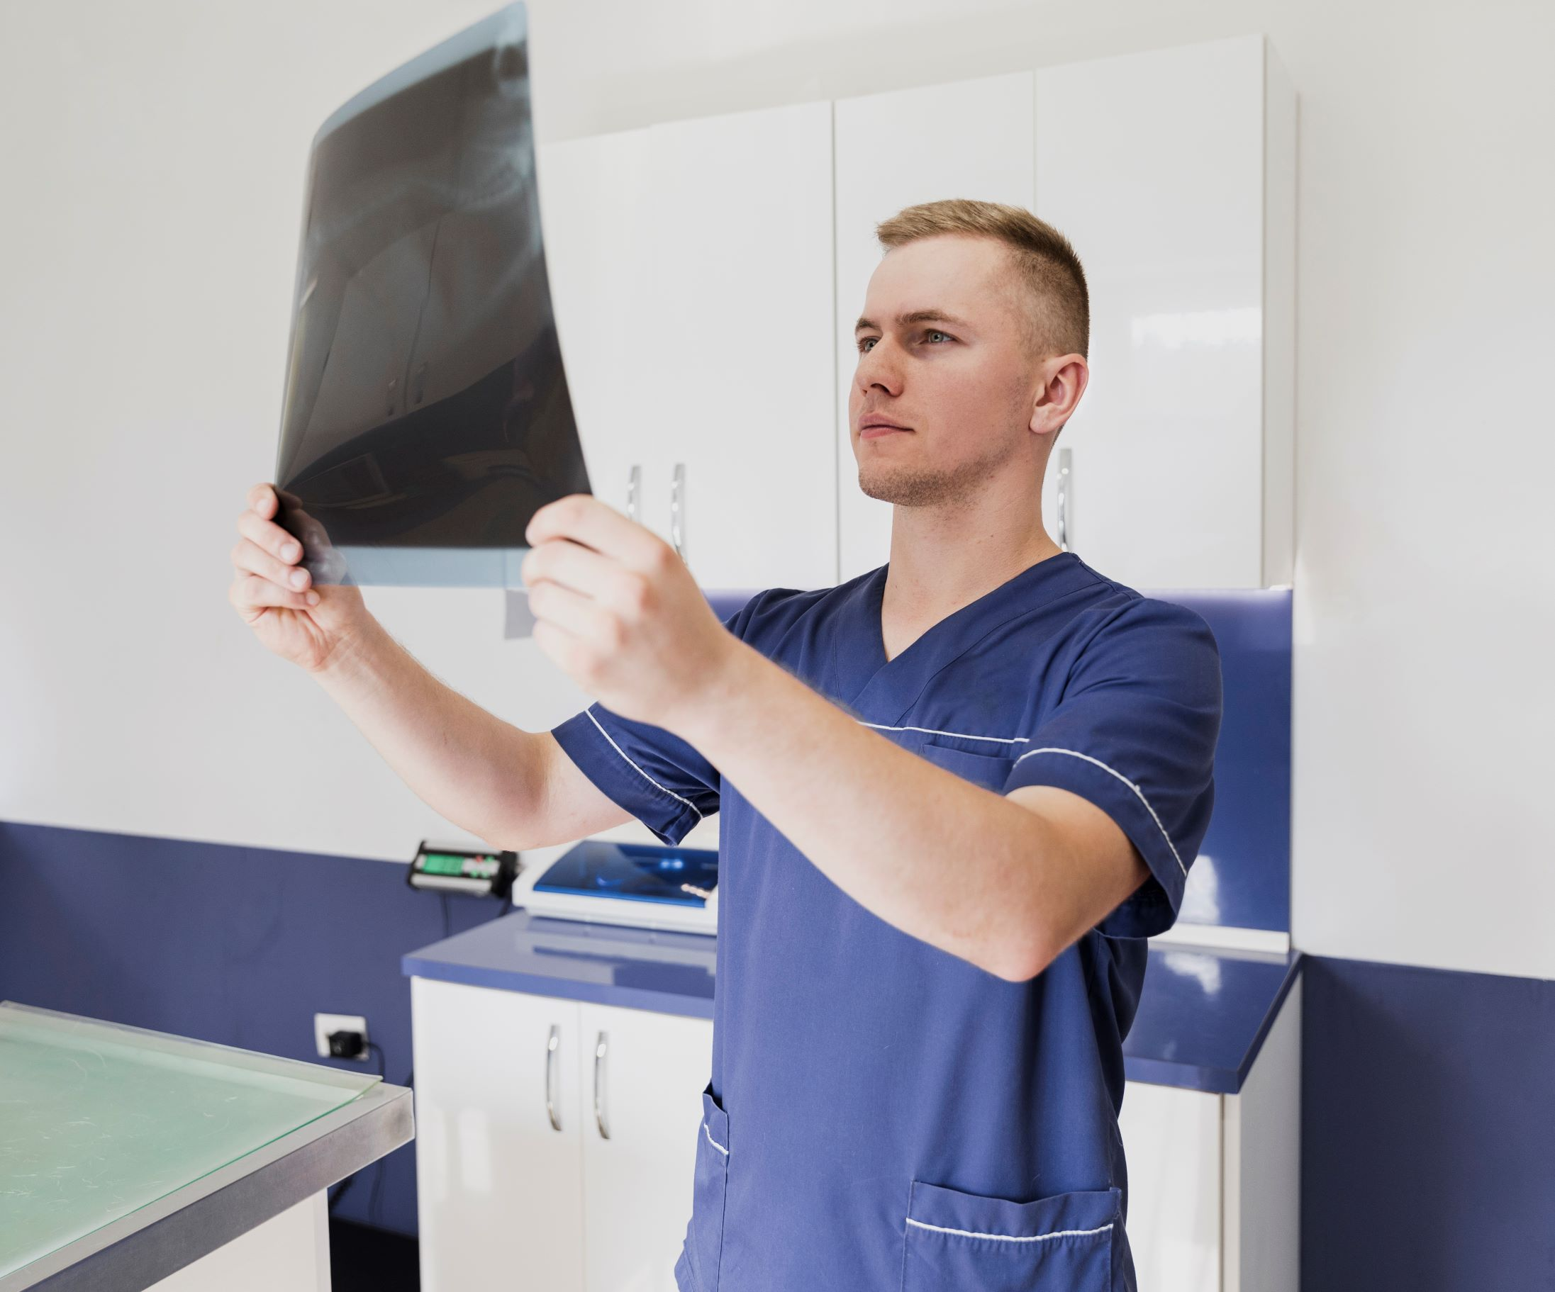
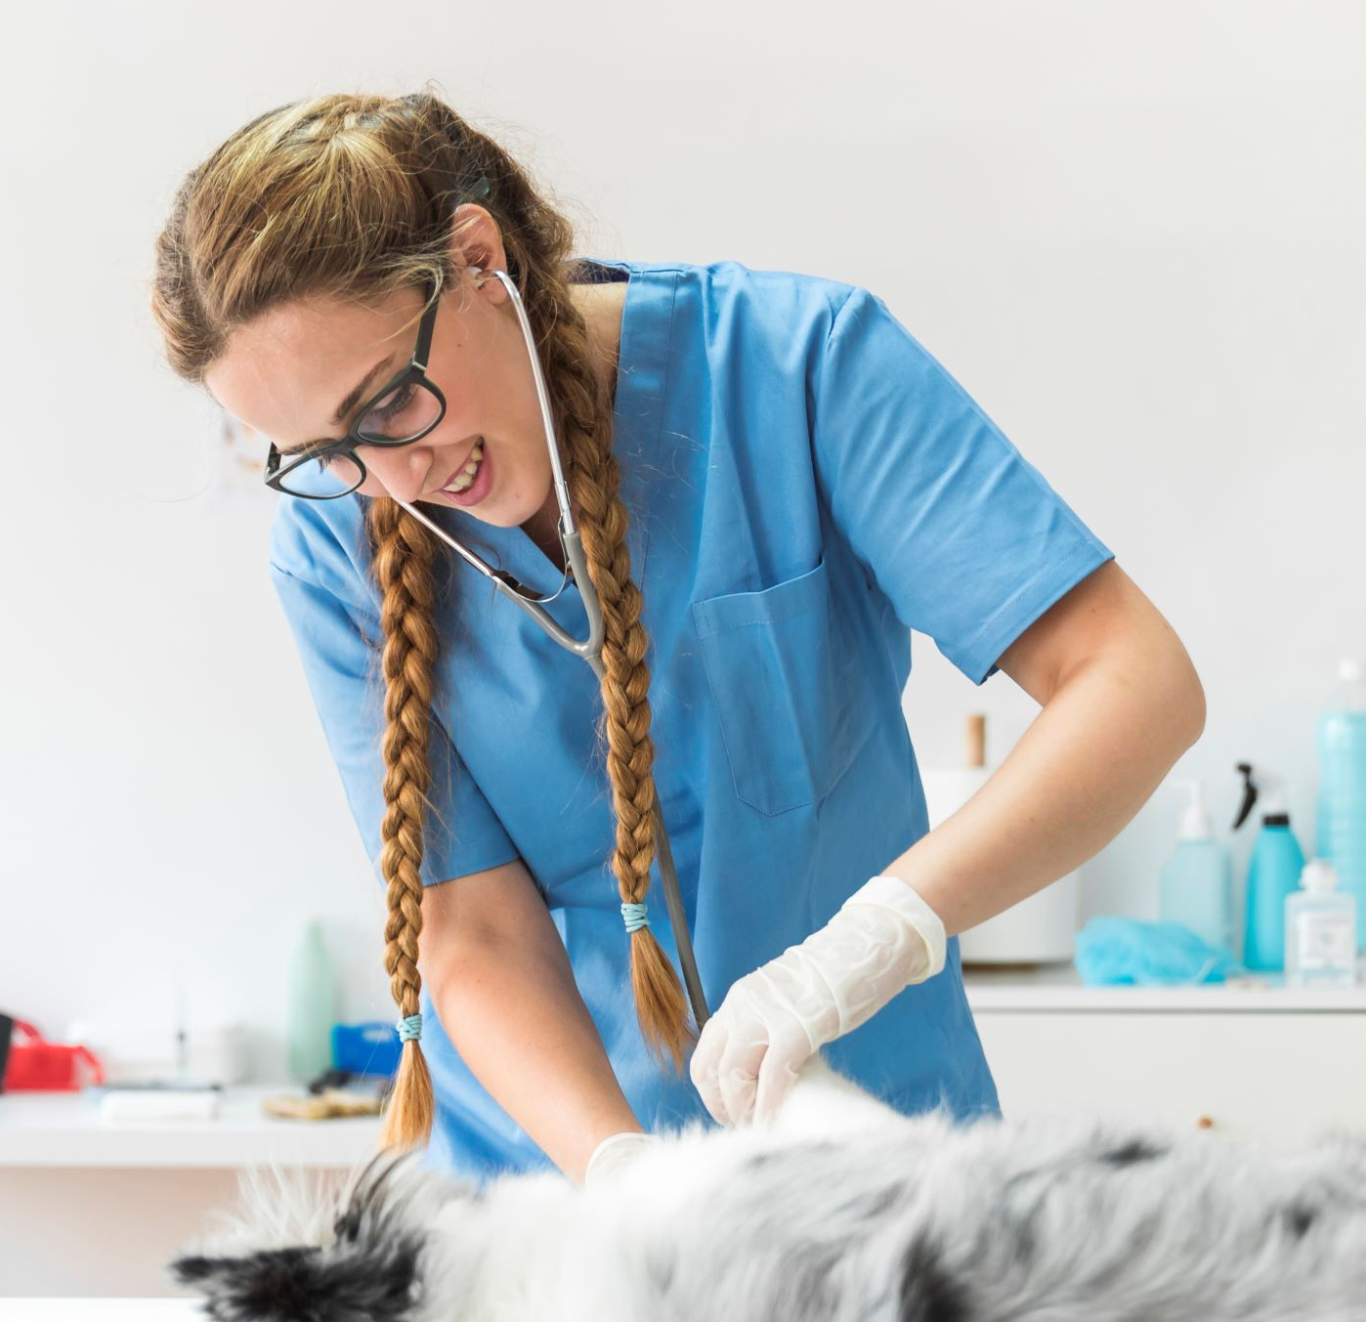
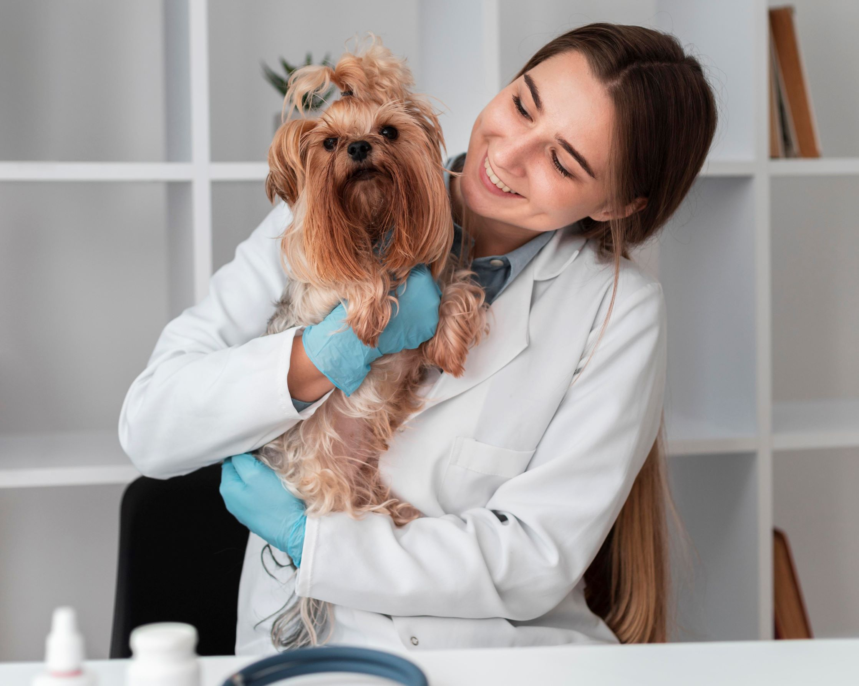

OUR TEAM
FADAK ALDAR
WEJDAN AL-AHMADI
SARA ALDUBAIE
NORAH ALHARTHI

Slide 30
THANKS! Any questions ?

